Slide 1
Corner Detectors
Motivation
Harris Corner Detector
Comparison of Corner Detectors

Slide 2
Suppose we only have a limited size of patch of window to look through.
How can we still recognize the picture?

Slide 3
Which is more distinctive?

Slide 5
Harris Corner Detector
We should easily recognize the point by looking through a small window
Shifting a window in any direction should give a large change in intensity

Slide 6
Let’s hunt for corner
First we need a window:
Then we calculate the intensity of the area:
Then we move it in x and y direction, calculate the intensity there again:
We want to now if shifting the window has caused a big change in intensity:

Slide 7
Continue reforming…
Taylor expansion:
Expand the equation :
Extract a matrix form :
Let’s denote:

Slide 8
Then the equation…
These are just products of components of the gradient, Ix, Iy

Slide 9
Intuitive Explanation:
Find the derivatives: Ix, I y
dx = [-1 0 1;
-1 0 1;
-1 0 1];
Ix =Conv2(Image,dx,'valid');
Iy =Conv2(Image,dx','valid');

Slide 11
Consider λ1 , λ2 as the eigenvalues of M

Slide 12
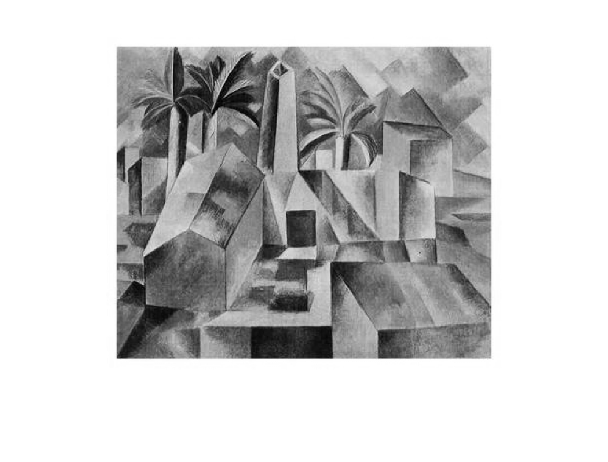
Sample Picture

Slide 13
detectHarrisFeatures(I)
detectHarrisFeatures(I,'FilterSize', 117);
'FilterSize’: Gaussian filter dimension: an odd integer value in the range [3, min(size(I))].
The Gaussian filter smooths the gradient of the input image.

Slide 14
detectFASTFeatures(I)
detectFASTFeatures(I, 'MinQuality', 0.5)
detectFASTFeatures(I, 'ROI', [1,1,100,100]);
detectFASTFeatures(I, 'MinContrast', 0.5);

Slide 15
detectFASTFeatures(I)
detectHarrisFeatures(I)
detectMinEigenFeatures(I)

Slide 16
SURF
FAST
BRISK
MSER

Slide 17
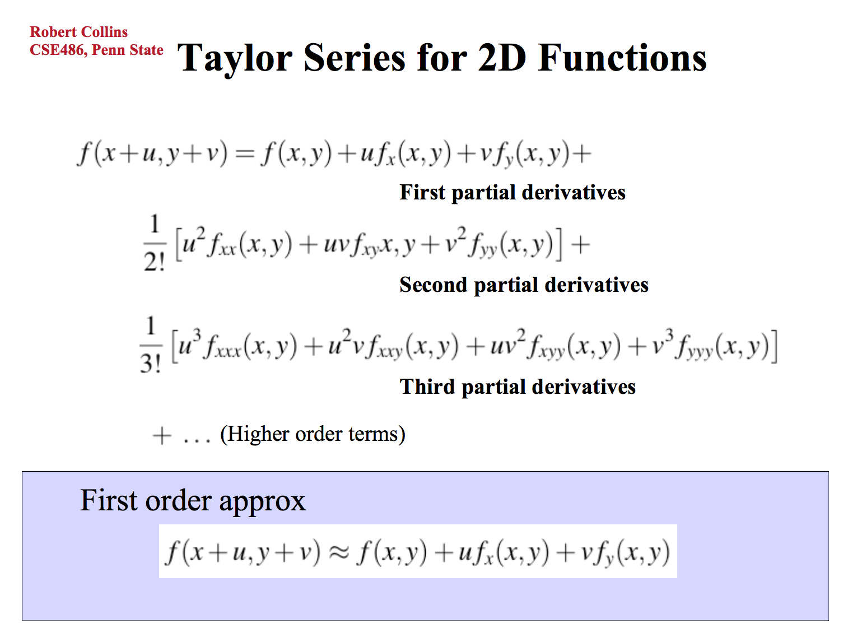

Slide 18
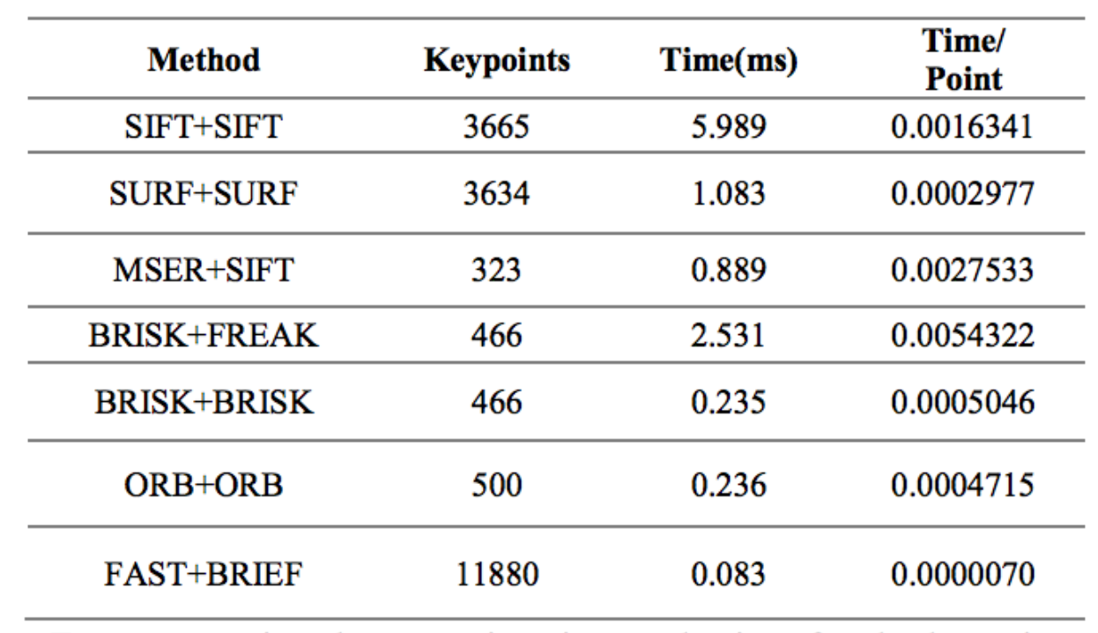

Slide 19
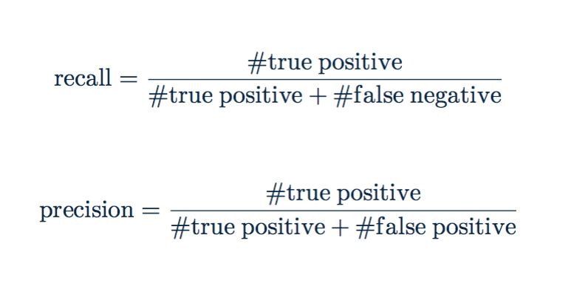
Notes:
the precision refers to the ratio of correct matched descriptors to the number of total positively matched descriptors which are number of keypoints in the reference image that have been matched.

